Slide 1

Real-Time Gesture Recognition System
This project develops a real-time gesture recognition system using EMG signals from the MYO Thalmic bracelet. The system processes gestures with high accuracy (94.5%) and low latency (0.12s), making it ideal for applications like rehabilitation and interactive gaming. We’ll cover the data processing, feature extraction, and machine learning methods used, along with the key results and future improvements.

Slide 2
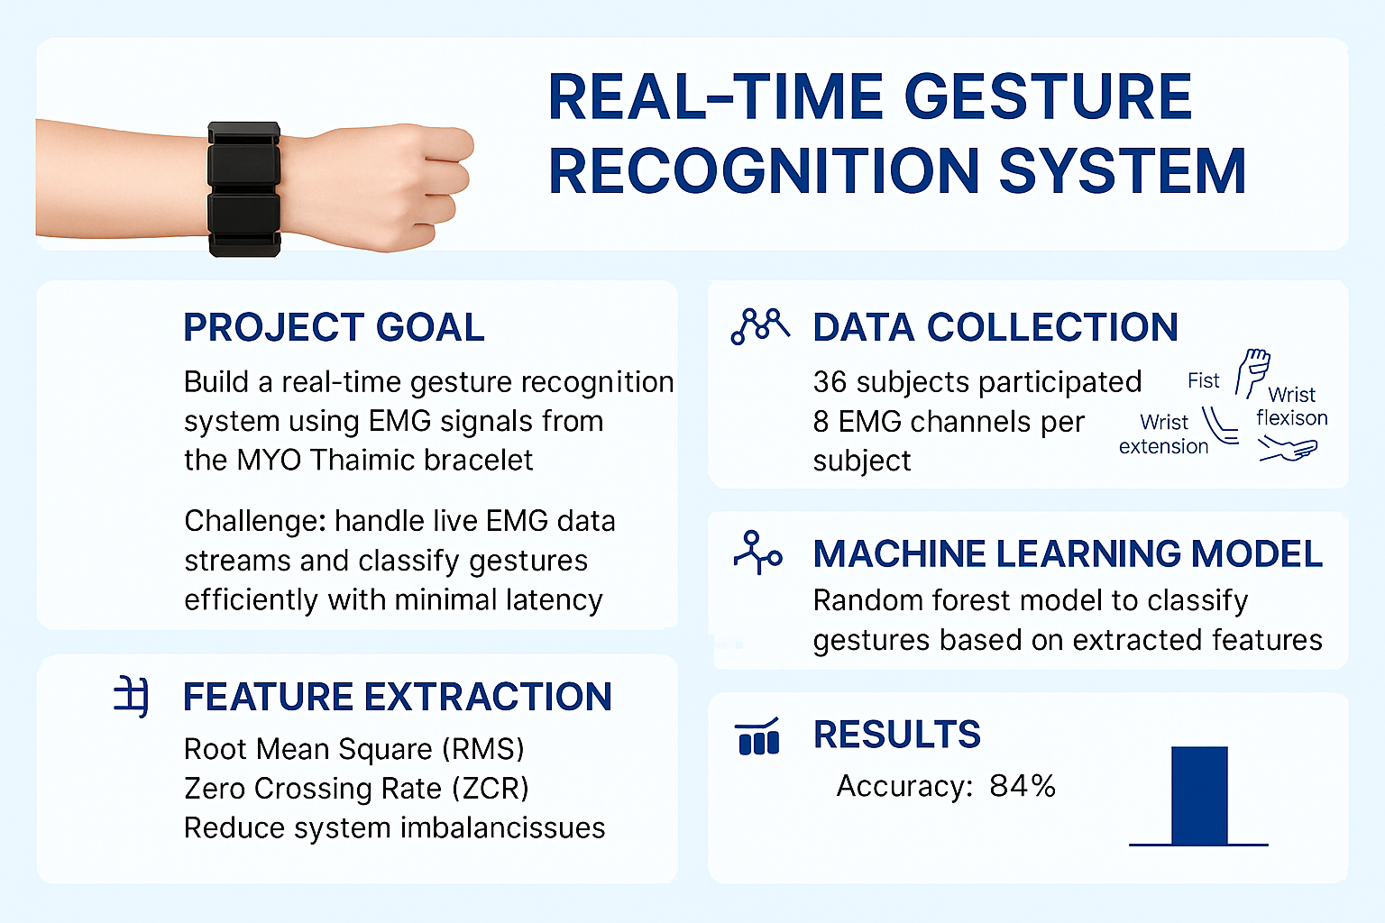

Slide 3
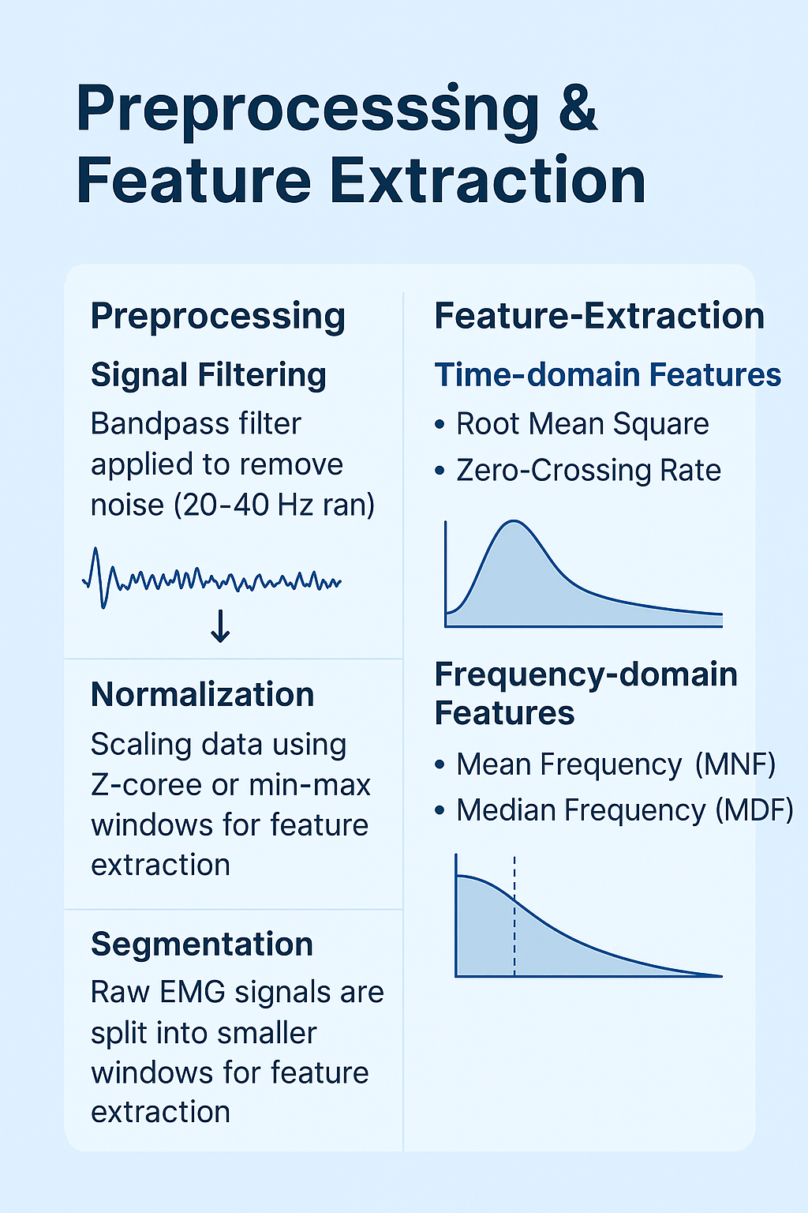
Preprocessing: Noise Reduction & Smoothing
Noise Filtering
Segmentation
Remove noise by using band-pass filter (20-40 Hz)
Divides raw EMG data into fixed windows for feature extraction
Normalization
Standardize data across subjects using min-max scaling

Slide 4
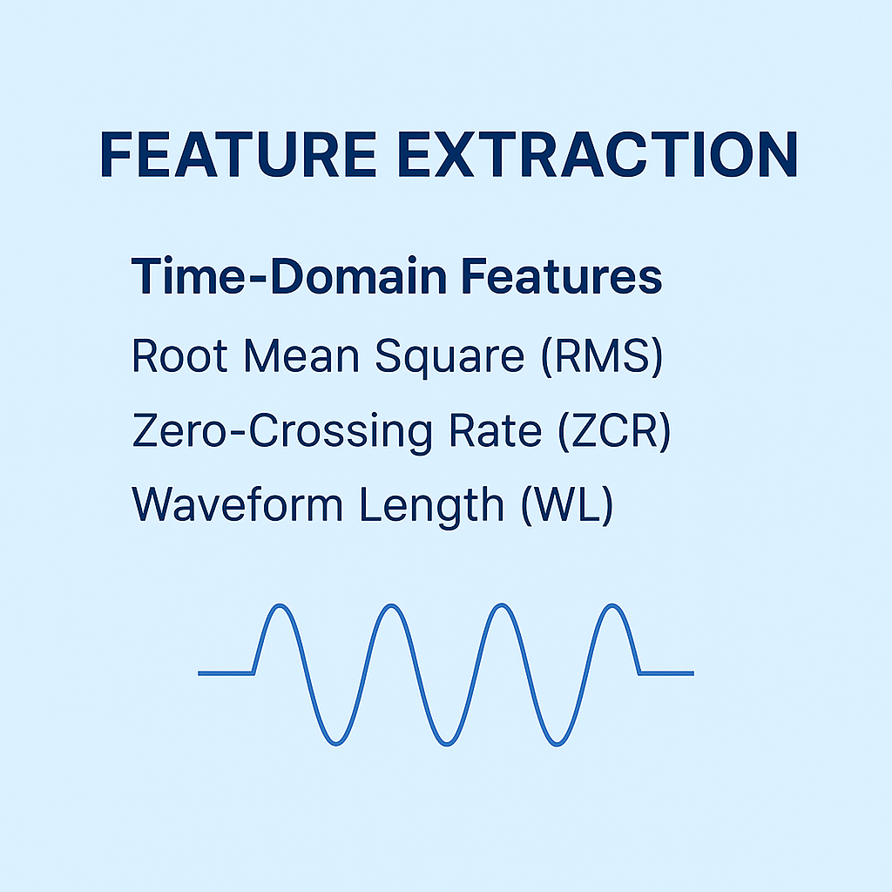



Preprocessing Techniques
RMS: Root Mean Square Error
Measure Signal Energy
ZCR: Zero Cross Rate
Counts signals sign changes
WL: Wave-Form Length
Measures the total length of the signal’s waveform over a given
window.

Slide 5
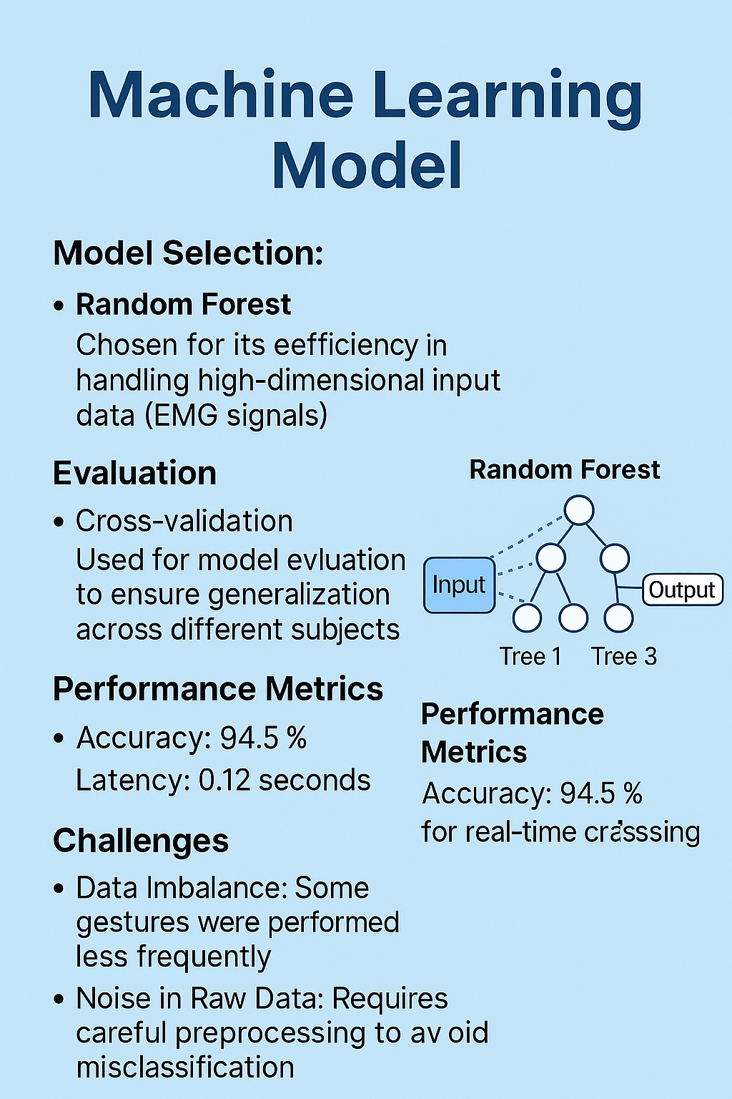
Machine Learning Model
The Random Forest model was chosen for its ability to handle
high-dimensional EMG signal data and minimize making it
ideal for complex datasets.
10-fold cross-validation was used during training to
ensure the model generalizes well to new unseen data.
Challenges included data imbalance, as some gestures
were less frequently performed, which affected
classification accuracy.
Noise in raw EMG signals required extensive
preprocessing to ensure the model’s accuracy in
gesture recognition.

